Slide 1
Cyclistic Data Analytics Cyclistic: How Does a Bike-Share Navigate Speedy Success?

Slide 2
hello!
I am Richard Carvalho
I am here to give the presentation on the case study of a fictional company named Cyclistic .
You can find me at Email: richardrc20072001@gmail.com
And at LinkedIn: https://www.linkedin.com/in/richard-carvalho-4640a718a

Slide 3
Background: what the company is
In 2016, Cyclistic launched a successful bike-share offering. Since then, the program has grown to a fleet of 5,824 bicycles that are geotracked and locked into a network of 692 stations across Chicago. The bikes can be unlocked from one station and returned to any other station in the system anytime.
Until now, Cyclistic’s marketing strategy relied on building general awareness and appealing to broad consumer segments. One approach that helped make these things possible was the flexibility of its pricing plans: single-ride passes, full-day passes, and annual memberships. Customers who purchase single-ride or full-day passes are referred to as casual riders. Customers who purchase annual memberships are Cyclistic members.

Slide 4
Problem
how annual members and casual riders differ.
why casual riders would buy a membership.
and how digital media could affect their marketing tactics.

Slide 5
1.
How do casual members and annual members differ

Slide 6
“One person can make a difference and everyone should try .’’
John F. Kennedy
So start to make a difference by
becoming a member.

Slide 7
Difference between members
This shows the difference between the average of rides in members.

Slide 8
Difference between members
The difference between the average of rides in members, by seeing this graph we can say that casual members are trying to get the most of their time, and the annual users are mostly using the bikes for day to day use but because of less amount of data we cannot get to this conclusion.

Slide 9
2 3
why casual riders would buy a membership
and how digital media could affect their marketing tactics.

Slide 10
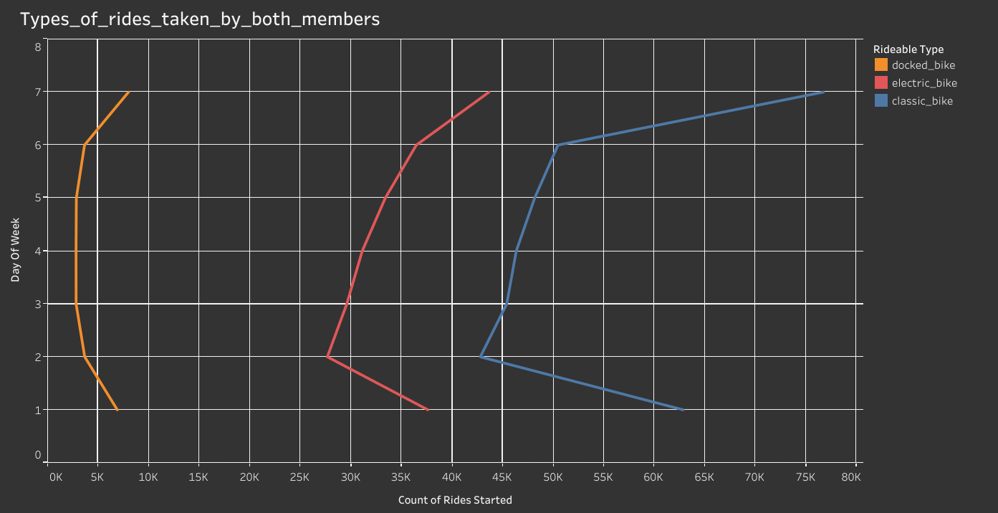
Rides used by members
There are three types of rides provided like docked bike, electric bike & classic bike.
The use of bikes increase at the end of the week as seen in the figure.
We could get the information/data on why casual member are using the bikes on the weekend and showing them the down side of not getting their desired bike or waiting for a bike as due to booked by an member and what value/features they are getting through the membership and send them personalized ads for buying the membership.

Slide 11
Pie chart
It helps us in recognizing which among the bikes are used more
We cannot say for what reason it is so but it could be due to pricing variations, or the classic bikes are being favorite/favored, or even their availability is more than the other bikes .

Slide 12
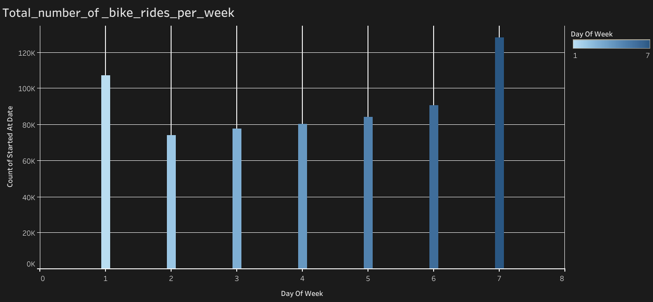
Rides used by members
The use of bikes increase at the end of the week as seen in the figure.
We could get the information/data on why there is a hike in use of bikes on the weekends and using the information/data send them personalized advertisement’s on the digital platform.

Slide 13
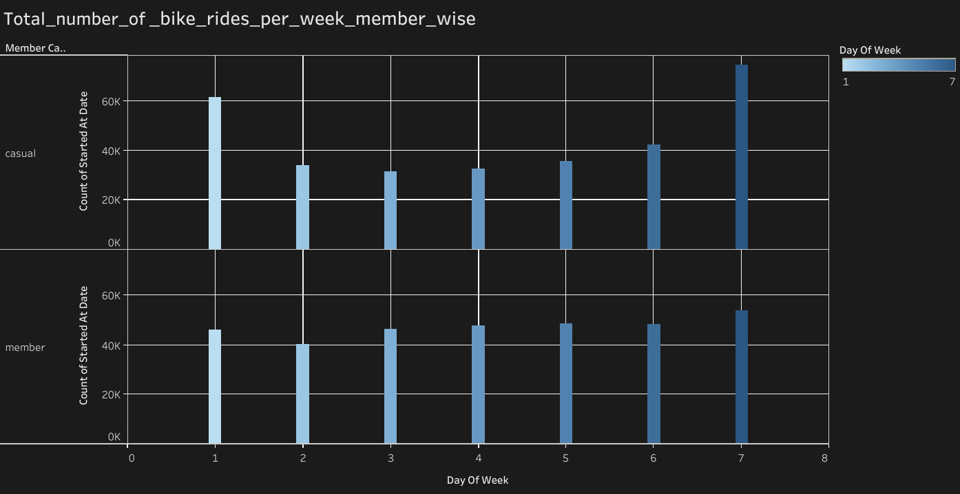
Member wise ride day wise
The use of bikes by casual users decrease at the mid of the week as member’s are consistent as seen in the figure.
As seen in the figure we can say that casual member’s are not using the bikes on the week days as compared to members as we have less amount of data we cannot determine the reason on why the drop in rides are being caused is it a pricing issue which is causing the riders to buy only weekend rides, or is the increase in weekend rides due to tourist visits during the weekend’s?.

Slide 14
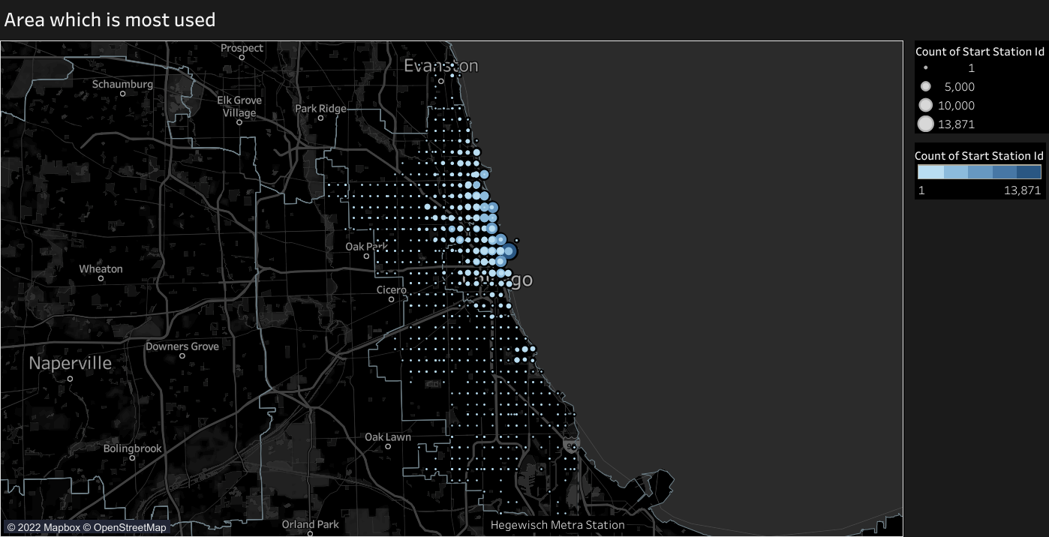
A map gives us a brief description
This map shows us which station/area have being used more.
But due to lack of data it is tough to discover the reason behind why they are being used more it could be due to beach side tourist usage, or even may be office locations are over in that area.

Slide 15
Key findings
Casual users tended to ride more so that they could make the most use out of their purchase (ticket) the services may be used for work purposes or tourist the reason is unknown.
Where as the members use their bikes for not more time but are consistent which may be because they are using it for daily work purposes , or other purposes
The electric and docked bikes are less used and the classic bikes are most used this may be varied due to pricing variations or availability of bikes.
The peak days on which the rides are taken most are during weekends for causal members , for annual members its consistent trough out the week
The station’s most used are near the beach side , this may be due to tourists ,or the office may be located in that area.

Slide 16
Recommendations
Introducing annual plans considering weekends as main objective that would be more appealing to casual riders .
We could alter the plans by making the single use more costly and as well as decreasing the annual membership / or giving them promotional discounts.

Slide 17
Things to consider before taking action
As the scope of data is limited which makes the decisions taken from this analysis a bit less reliable.
Even more data points could have brought in a lot of variation in the decisions to be taken.
Data points like data from whole year or even more, age, gender, occupation, pricing structure, recommendations from the users .

Slide 18
Resources
This template is free to use under Creative Commons Attribution license. By slides carnival
The data was made available by coursera by Motivate International Inc.

Slide 19
thanks!
Any questions? Or recommendations
You can find me at
richardrc20072001@gmail.com
LinkedIn: https://www.linkedin.com/in/richard-carvalho-4640a718a

